Slide 1

DM
(Direct Message)
PL-Cloud 이정욱
OITA 하선영
BITA 노승업
OITA 김남태

Slide 2
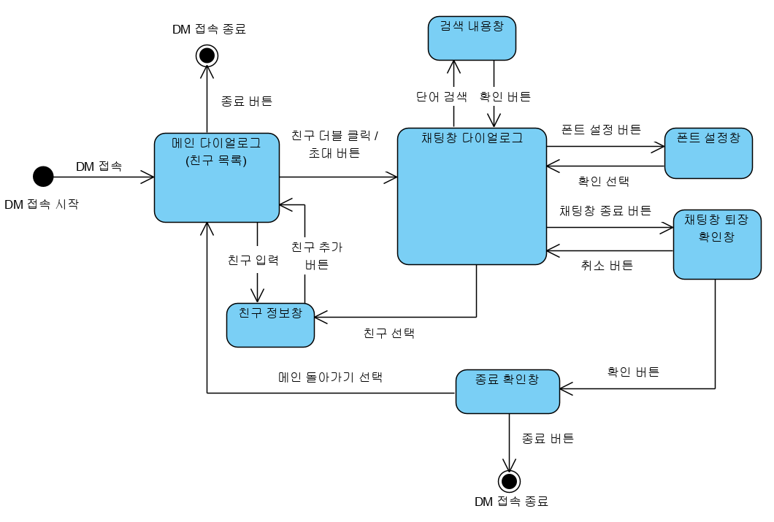
Event Diagram
-State diagram-
하선영
Design Diagram

Slide 3
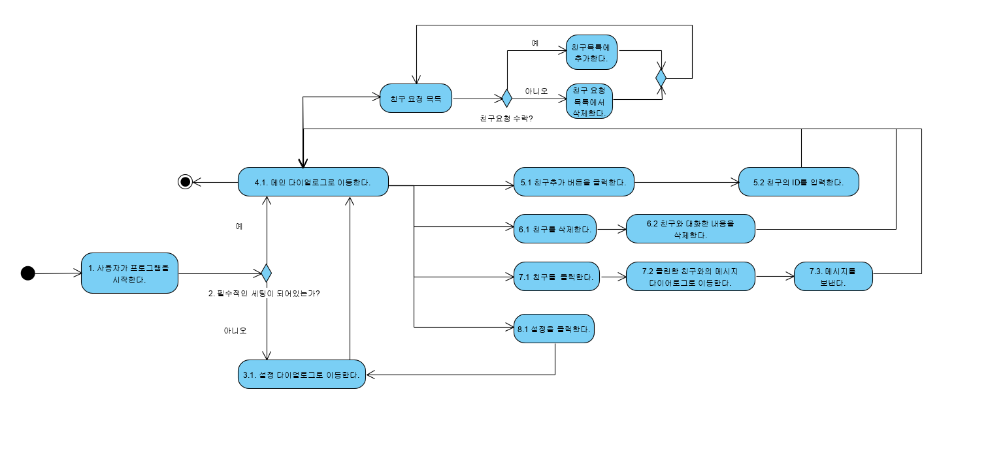
User Activitiy Diagram
-Use case-
노승업
Design Diagram

Slide 4
https://ovenapp.io/view/frL2SexCF1Tg2hJe0n2TBFzQbTs19vy5/
Design Diagram
-UI-
김남태
Design Diagram

Slide 5
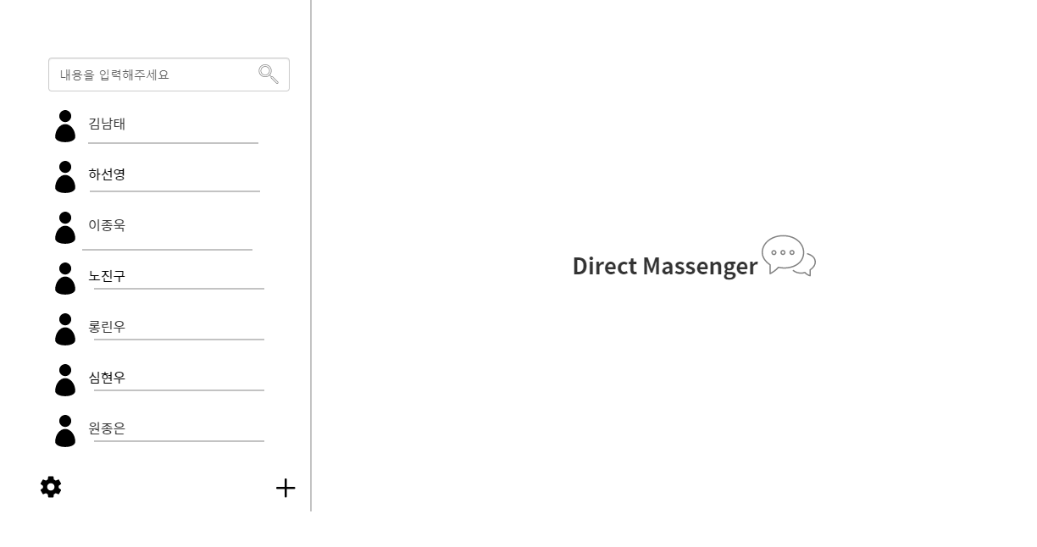
Design Diagram
-UI-
김남태
Design Diagram

Slide 6
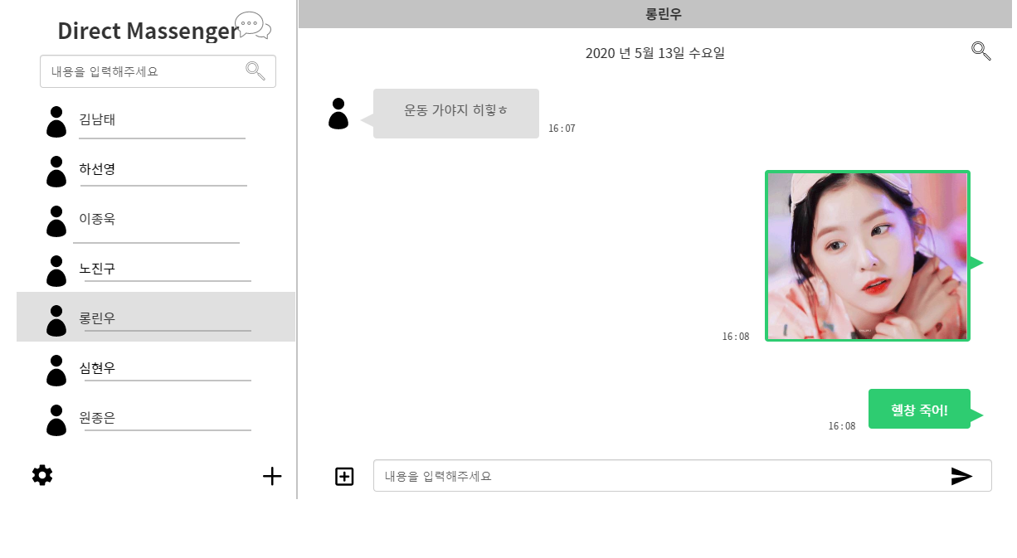
Design Diagram
-UI-
김남태
Design Diagram

Slide 7
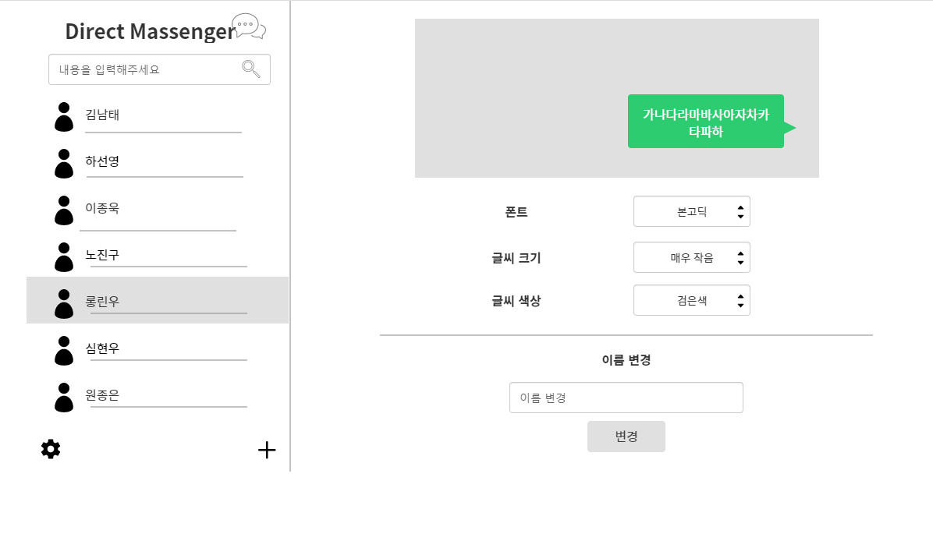
Design Diagram
-UI-
김남태
Design Diagram

Slide 8
Variables
-Design-
이정욱
class
클래스
추가구현
Design Diagram
Main Dialog
[friendDialog]
Vector<Friend> friendList
void addFriend(string name, string IP)
void SearchFriend(string name)
void DeleteFriend(string name)
void AddChatDialog()
Chat Dialog
Vector<string> conversationList
Void SendChat()
Void SendFile()
Void recvName()
Void saveConversation()
Void updateTime()
Void searchConversation()
Setting Dialog
Property:
Font font
String Nickname
Color color
Int fontSize
DB
FriendList.txt
ConversationList.txt

Slide 9
역할 분장
공통 필요기술
객체지향 프로그래밍
C++
MFC
Sokcet Programming
STL (Vector만 사용)
Git
Design Diagram
담당 역할
UI Design / Programming – 김남태
System Design / Programming – 노승업
Socket Programming / data communication – 하선영
Project Manager -이정욱
Code Convention
: Camel case
목표
: 배운 걸 다 써먹자.

Slide 10
DM
(Direct Message)
감사합니다.
PL-Cloud 이정욱
OITA 하선영
BITA 노승업
OITA 김남태

